Slide 1
Data Pre-Processing Pipeline Development
Notes:
So today I’ll be presenting the project what I have been working on since the start of my internship which is the development of a data pre-processing pipeline.

Slide 2
Outline
Introduction
Design Requirements for the Data Pre-Processing Pipeline
Notes:
The outline of my presentation includes the introduction of the project, consisting of the background and purpose of the project and subsequently the components of the data pre-processing pipeline and its outputs.

Slide 3
Introduction
Project Background
Past developments and past models were created to obtain trends from raw data to better future business decisions, improve product efficiency and achieve business goals
However, different functions in different developments could not work with the same dataset
Variations (delimiters, naming conventions)
Purpose of Project
Design a pre-processing pipeline
Clean, transform data
Complete, correct, consistent data
Notes:
project background
In the past, within EDPR Sunseap, a few developments or models were created to predict trends and information from raw data collected from our products at several site locations. These trends and conclusions can better support future business decisions, improve our product efficiency and achieve business objectives.
However, when trying to use the same dataset to gain different insights (with the use of different models or algorithms), these algorithms could not work due to many variations in the raw dataset (for example the way the data columns are named or the way the data values are separated and ordered (delimitations)).
purpose of project
The purpose of this project is to design a data pre-processing pipeline that helps clean and transform the raw data into a format that can be used in different developments for different functions. By cleaning the data beforehand, we have a complete, correct and consistent set of data which can speed up future development processes produce reliable and accurate results from the ML models.

Slide 4





Design Requirements
5 stages for pre-processing data
Raw data Input
Data Quality
Data Transformation
Meta Data
Data Publication
Notes:
The first stage of pre-processing data is to identify where to place the raw data files to begin their processing. Next, we ensure data quality such as identifying duplicated records and outliers. Thirdly, we perform data transformation to make the data more suitable for analysis or visualization. For example using logarithmic transformation to reduce the effects of outliers and skewness. Next, we generate a metadata file alongside the cleaned data to provide context and information to quicky get an overview of the cleaned data. Some metadata includes: Location information of where the dataset is acquired from, number of missing values in the dataset and the number of outliers within it. Lastly, we publish the data in a catalogue to help users find and access the data they need quickly.

Slide 5
1st stage: Raw Data Input
Notes:
So in the first stage of the pipeline. 1.1. Specify a folder to place raw data files and to initiate data pipeline.
1.2. Be able to handle a single data file with data spanning across multiple months.
1.3. Be able to handle multi data files with segments of data within the same month.
1.4. Do not need raw data files once the raw data has been processed.
1.5. Retain data file and prompt user if raw data files cannot be processed.

Slide 6
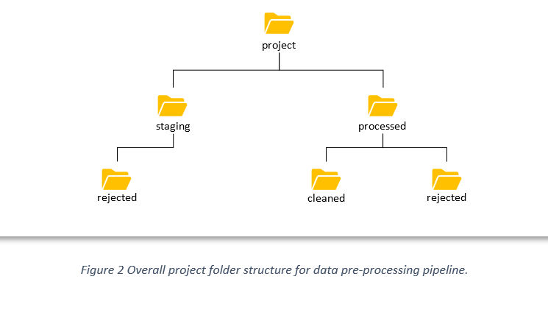



1st stage: Raw Data Input
Notes:
We have the overall project folder structure. The raw data files will be placed in a folder named “staging”. Once the file has been processed, the raw data file will be deleted from the staging folder. Files that cannot be processed will not be deleted but instead be moved to these rejected folders and be informed to the user.

Slide 7
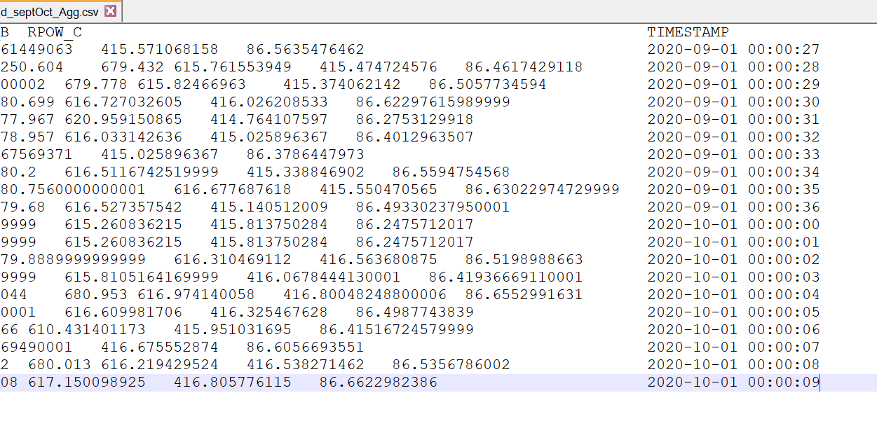
Single data file spanning across multiple months
1st stage: Raw Data Input
Notes:
The program can accept raw data files that consist of many different months within it and when processed and outputted, it gives cleaned data files that are separated by their months respectively.

Slide 8
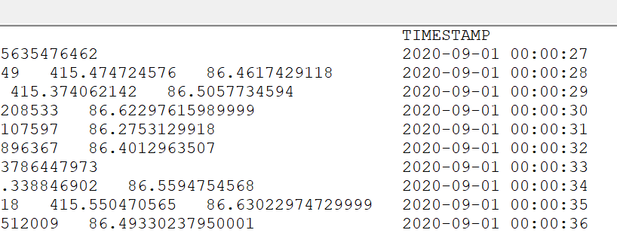
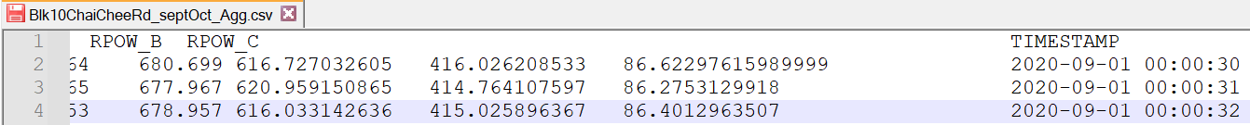
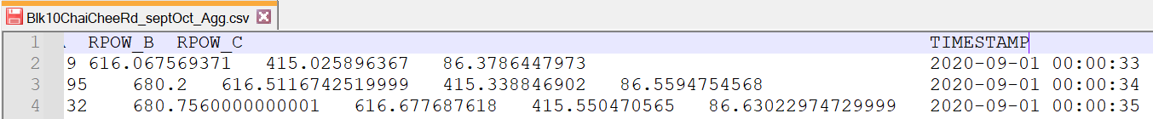
Fragmented files of the same month
1st stage: Raw Data Input
Notes:
The opposite is true also, the program can take in small pieces of files that are of the same month and produce a combined, complete file of that month

Slide 9
2nd stage: Data Quality
Notes:
The second stage of the pre-processing pipeline is data quality
2.1 Ensure dataset does not contain duplicate columns. A duplicated column is where all its values and column names are identical.
2.2 Standardize column headers.
2.3 Standardize delimiters to comma.
2.4 Check for missing values.
2.5 Check for outliers.
2.6 Check for time gaps.

Slide 10
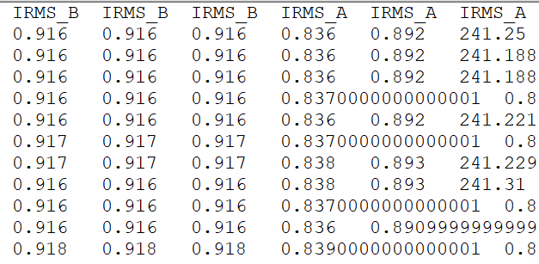
Duplicated columns
2nd stage: Data Quality
Notes:
In Data Quality, we made sure to remove any duplicated data within the dataset to prevent bias analysis and ensure consistency in the cleaned data. For example, if we recorded the “Current” value from a “Lift” at one of our site and we receive two exact copies of the data columns: “IRMS_B” and “IRMS_B” we would check against all their corresponding values before removing one of the columns entirely.

Slide 11
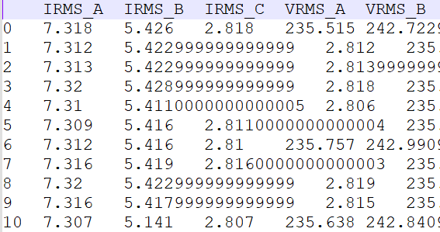
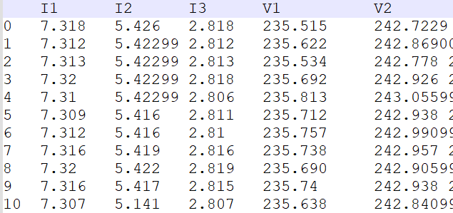
Standardized headers and delimiters
2nd stage: Data Quality
Notes:
We ensure that all our data columns have consistent and standardized names. We also ensure that our cleaned data files have standardized delimiters such as the spacing between values and column names.

Slide 12
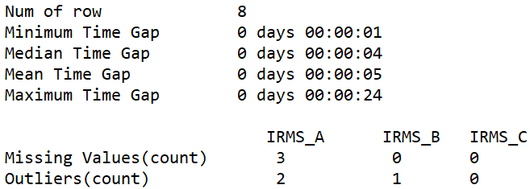
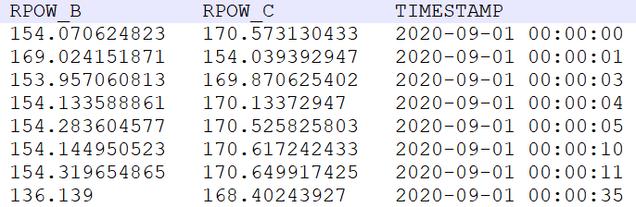
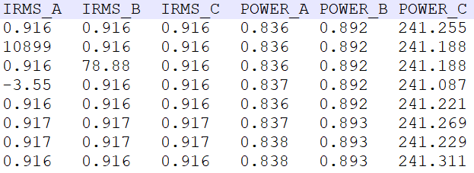
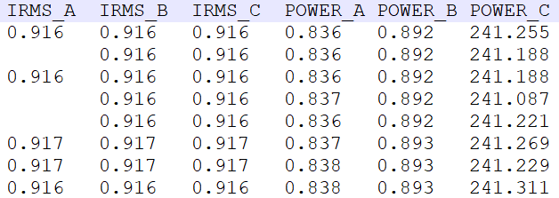
Check for missing values, outliers and time gaps
2nd stage: Data Quality
2 sec
E.g Avg = 35/7 = 5 sec
5 sec
24 sec
Notes:
We keep track of the number of missing values in our data files to handle them in the future. Such as using interpolation in the future if needed
We keep track of the number of outliers in our data files using an Inter Quartile Range to identify extreme values in our dataset.
We keep track of any time gap statistics in the data file for example the time intervals between each data row, the maximum, minimum, median, time gaps in the data file.
We store all these information in a meta data file that will be generated alongside the cleaned data file which I will be showing in greater detail later.

Slide 13
3rd stage: Data Transformation
Notes:
The 3rd stage would be to transform the data to help with standardization and improving the interpretability of the data. Data transformed may also improve the accuracy and reliability of machine learning models.

Slide 14
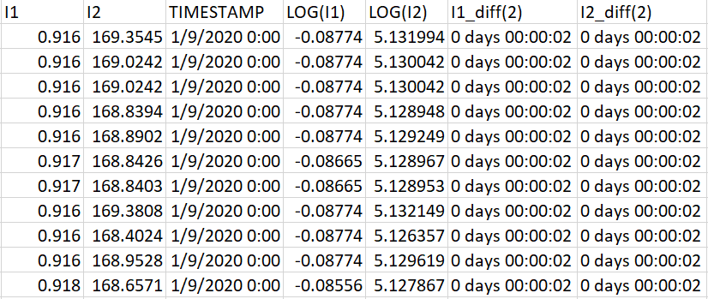
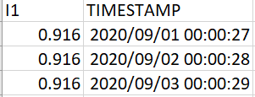
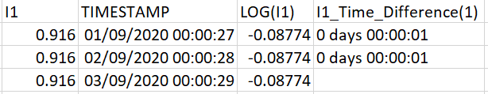
Date-time format, logarithmic transform, time differencing
3rd stage: Data Transformation
Raw data
Time diff = 1 sec
Time diff = 1 sec
After processing
Notes:
In this stage, we transform all datetime formats into a standardized format for consistency and we also create a function for the user to convert their data (for example the Current data column) into it’s respective logarithmic scale. The user can also generate the time difference data between rows for further analysis in the future should they need it.
On a bigger data set, this is what the transformed TIMESTAMP data and generated log & time_diff columns would look like.

Slide 15
4th stage: Metadata
Notes:
The 4th stage, the second last stage, would be the generation of the metadata file. A metadata file is useful to have a quick glimpse or summary of the cleaned datafile at hand to assess its quality, or to find out if the data is useful for our current analysis objective (E.g if we looking for species, colour type of data but metadata show columns like power factor, energy usage. Meta data provides a quick view of the file within)

Slide 16
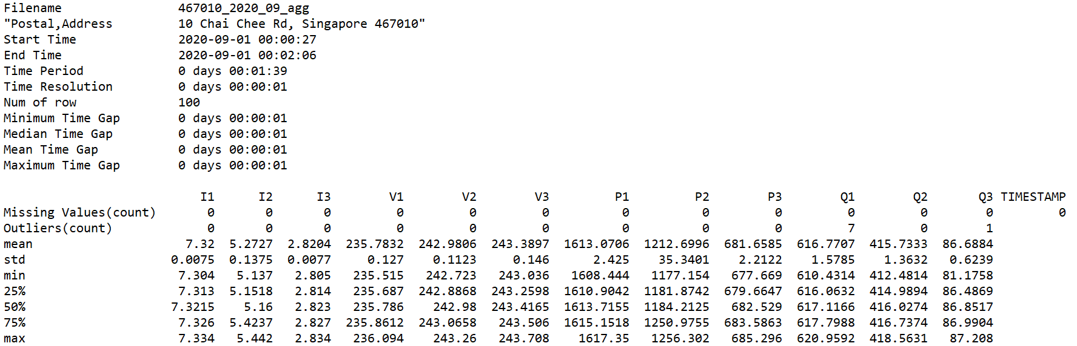
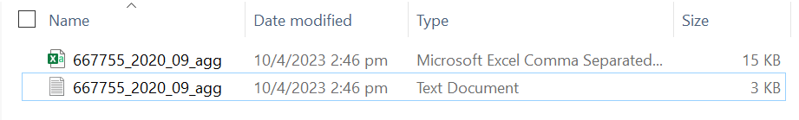
4th stage: Metadata
Notes:
By analyzing the raw data file, we are able to get metadata information such as its filename, address, time information, time gap statistics, missing values, outliers, and more statistics for our data. We include all these information in a txt file which is generated alongside the cleaned data file in the same folder.
We can immediately tell if the data contains too many missing values or outliers to be used to train our model or to provide an accurate analysis. The standard deviation and interquartile ranges gives some indication of the spread or variability of the dataset to show if the data is biased or skewed.

Slide 17
5th stage: Data Publication
Notes:
The final stage would be to publish the data in a catalogue.

Slide 18
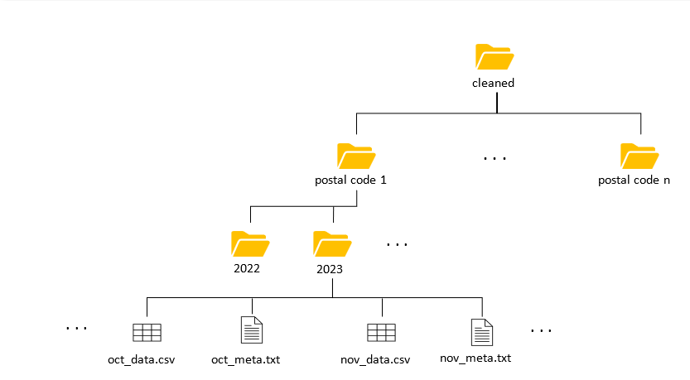
5th stage: Data Publication
Notes:
Recall the earlier overall project folder structure. The processed data files will be located in the “cleaned” folder. And within it, cleaned data files will be categorized according to their postal code first (where the data was collected from) followed by their respective year (when the data was collected). This will allow users to select their cleaned datasets from their location of choice first and then select their datasets according to their year of choice.

Slide 19
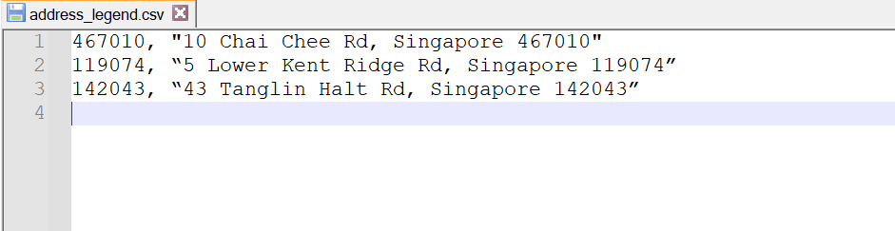
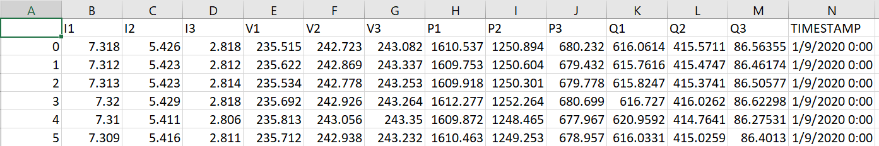
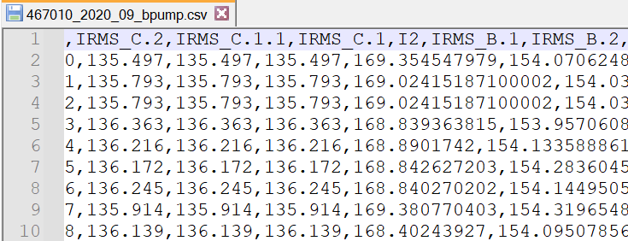



Monthly datasets, ‘,’ delimiter, address_legend.csv
5th stage: Data Publication
September
Notes:
The cleaned files will consist of exactly one months worth of data readings which can be seen from their file names.
The data will have ‘,’ as its delimiter to have a clear, organized view when displayed in Excel.
Whenever the program reads a file that has a new address or location, it prompts the user to key in address’ postal code. This postal code will be stored in a file called “address_legend.csv” which acts like a database of addresses.

Slide 20
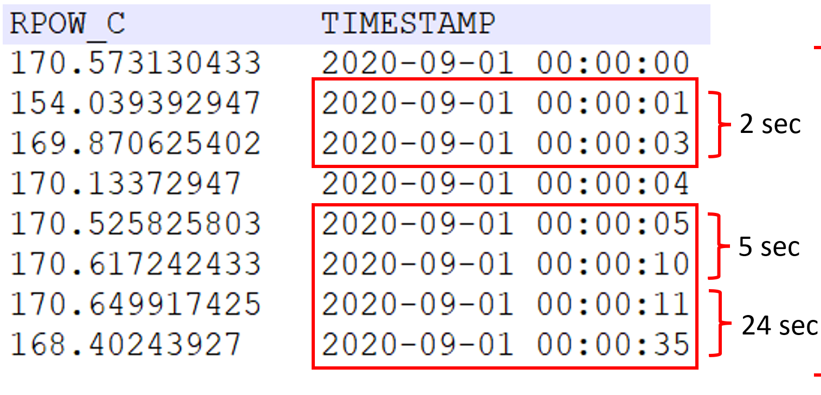


Rejects
5th stage: Data Publication
Two criteria
1. postal_code_YYYY_MM_load.csv
2. time gap threshold
Notes:
Unfortunately, for files that do not have the appropriate naming format of: postal_code_year_month_load.csv, they will not be processed through the pipeline. They will be rejected and place in the rejected folder under “staging” directory.
Additionally, the user can specify a “time gap” threshold for the program to reject files that consist of too much missing data. For instance, if threshold is “500 seconds”, datasets that are missing 500 seconds worth of data will be rejected under the “processed” directory.

Slide 21
Example
Notes:
TEST_CASE = ‘present’

Slide 22
Q & A
What are the benefits of pre-processing data?
Pre-processing data removes missing or inconsistent values within the data set (NaN or NaT). This can improve accuracy and quality of a data set. E.g Dataset consist of people’s birthdays. US format would be mm-dd-yyyy whereas European format would be dd-mm-yyyy. If this data were to be passed through the algorithm, the model will be trained incorrectly and inaccurately to predict future birthdays of new people.
How do you ensure data quality
We analyze the raw data and handle missing values, inconsistent data types, outlier and duplicates. We account for these missing values, outliers and duplicates. We standardize inconsistent data types (E.g dd-mm-yyyy). We cross-reference the addresses of our raw data files with an existing list of official addresses to ensure data consistency.
What are the steps involved in pre-processing data?
Raw data input -> Data Quality -> Data Transformation -> Meta Data -> Data Publication

Slide 23
Q & A
Can you explain how you handle missing data?
We take into account the number of missing data in the dataset and include it in the metadata text file
How do you deal with outliers?
We identify a lower Q1 – 1.5*IQR and upper Q3 + 1.5*IQR threshold and any value that is outside these thresholds are considered outliers.
What are the tools and technologies used in data pre-processing
I use VS Code IDE and python tools to help build this pipeline
Can you give an example of a real-world problem that was solved using data pre-processing?
By performing data analysis on our cleaned data, we can identify power consumptions patterns across the year (seasonal changes), peak hours, and daily usage trends. This allows us to regulate/ optimize/ adjust electricity outputs to reduce waste and lower costs for our clients and for ourselves the providers as well.
Notes:
Interquartile range = (75% - 25%). We can ignore any values below 25% and 75%. (but why do we do this?)
IQR is used to determine the amount of “spread” in the data (why and how)
A large spread shows how widely scattered the data points are and a small spread shows how tightly clustered they are.
A wide spread in our data shows high volatility and fluctuations. In terms of power consumption it shows if the power is provided is stable or not.

Slide 24
Q & A
What are the most common challenges faced in pre-processing data?
Data transformation: transforming variables (features) in the data
Data Integration: identifying and combining identical sets of data. Differences in data formats and data quality must be accounted for

